Slide 1
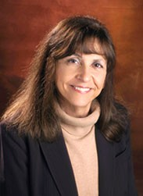
The Contributions of Nancy Leveson to Systems and Software Engineering
Notes:
There is no specific introduction slide. Use this slide during a brief verbal introduction. Will’s section ends up being a good introduction to safety issues anyway.

Slide 2
Education, papers and awards.
Educated at UCLA
Currently teaches at MIT
Has written a book and multiple papers
Received multiple awards in the computing field

Slide 3
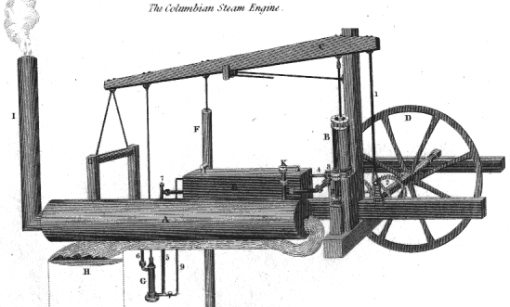
Software Safety
What is safe?
What are the major safety flaws?
Systems are complex and cannot be completely understood.

Slide 4
Requirements Validation
Software Deviation Analysis
Effective Software Reuse
SpecTRM

Slide 5
The Human Element
Draws from many disciplines
Importance of interfaces
  For the user
  For the developer
Intent specifications

Slide 6
Research Contributions
Principal case studies
  Therac-25
  TCAS II
Interesting because:
  Complex systems where safety is important
  Technical and ethical issues

Slide 7
Therac-25
Identified problems:
  Too much reliance on computer control and monitoring of the hardware
  Poor software reuse procedures
  Inadequate procedures for handling reported accidents

Slide 8
TCAS II
What it was?
  An avionics system required on all commercial aircraft with more than 30 passengers
What was the problem?
  Original requirements were in English and a low level pseudocode which was unacceptable for government certification
What was the solution?
  Reverse engineering of the old requirements using an easy formal specifications language called RSML

Slide 9
Conclusion
Role of software in critical systems is growing
Complexity of these systems is growing.
Accidents are expensive
Ethical responsibilities are increasing.
Dr. Leveson continues to lead the way.

Slide 10
Thank You
Will Cater
Aldo Doronzo
Robert Shields

